Slide 1
Historical OHLCV Data
Historical Social Media Data
Historical News Data
Streaming Data
CryptoCompare
API
Twitter
API
Google Trends API
Google
Geocoding
API
1. Fetch Geolocations of different Exchanges and Trades
1. Live Twitter Feeds
NEWS
API
1. Live Google Search Trends
2. Historical Google Search Trends
1. Cryptocurrency Specific News
CASSANDRA

Slide 2

1. Can we predict the future price of different cryptocurrencies using historical data and news sentiment polarity for the top cryptocurrencies?
2. How to understand the price and transaction behavior of the fluctuating cryptocurrency market and see if there is any correlation for the change?
3. How can we do visualization on live and streaming data and visualize the effects of different parameters that affect cryptocurrency prices?
4. Can we visualize cryptocurrency exchanges worldwide by volume in real-time?

Slide 3


Slide 4

Our Findings
24/7 Markets

Slide 5
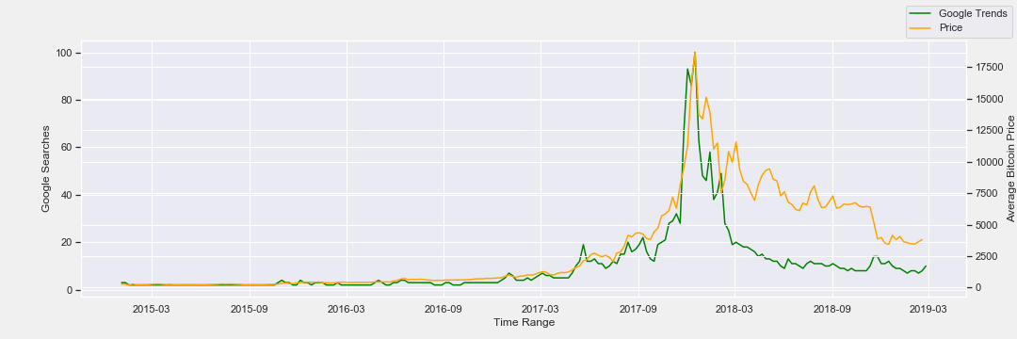

Slide 6


Slide 8

Easy To Use
Beautifully
Designed
Let Users Have Knowledge Like A Pro Without Being A Pro
THE SYSTEM

Slide 10

Random
Forest

